Slide 1


AUTOMATED GENERATION OF VIRTUAL MACHINE IMAGES WITH HASHICORP PACKER
NECATİ TURAN-IŞIL ALICI-YAREN MISIRLI
ISTANBUL KULTUR UNIVERSITY

Slide 2
Index
04
1
Experimental Studies
03
Methodology
02
Introduction to Cloud Systems :
Why we even need AMI manipulation with packer ?
Related Work: How the opponents work and why we should adapt immutable infrastructure with Packer?
01
Automated Generation of VMIs with Hashicorp Packer

Slide 3
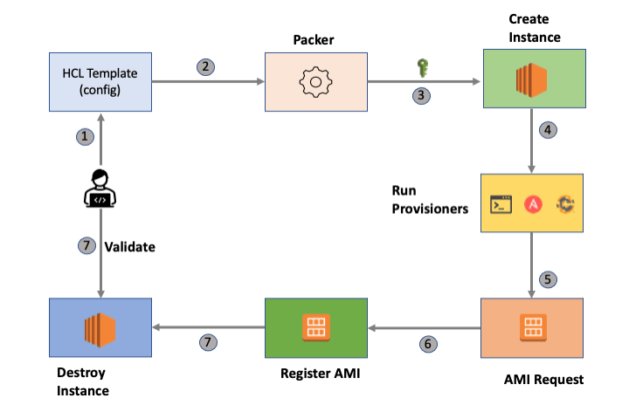

Slide 4
1. Introduction
2. Related Work
3. Methodology
4. Experimental studies
5. Discussions
6. Conclusions

Slide 5
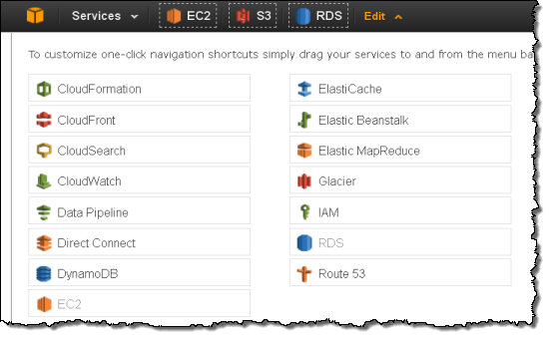

Slide 6
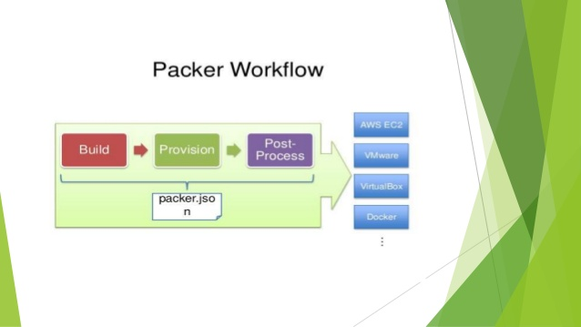

Slide 7
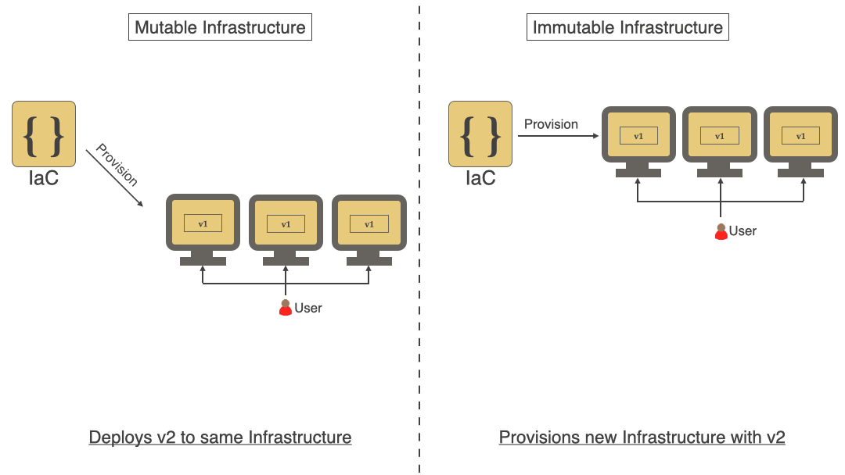

Slide 8
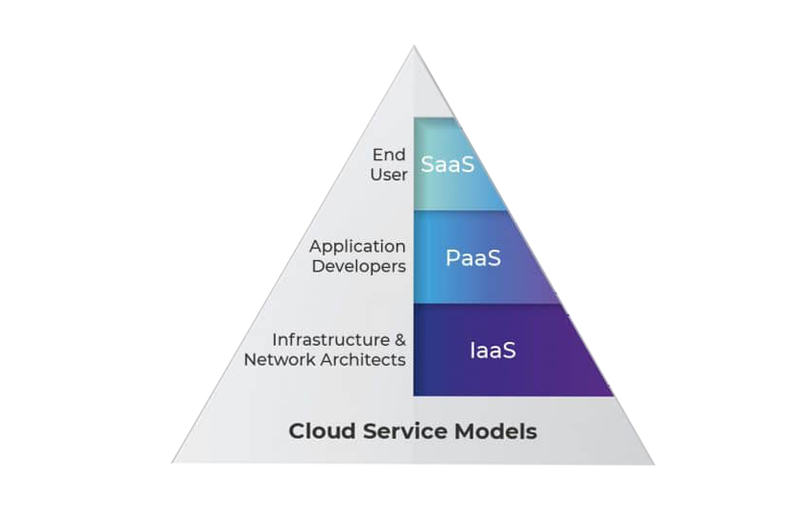
2
There are broadly known three layers of clouds;
Infrastructure as a Service -IaaS-,
Software as a Service -SaaS-,
Platform as a Service -PaaS-

Slide 9
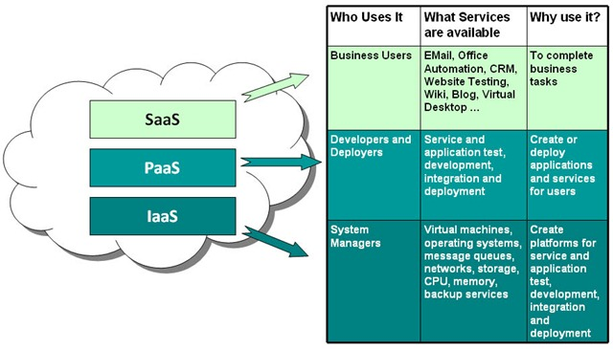

Slide 10
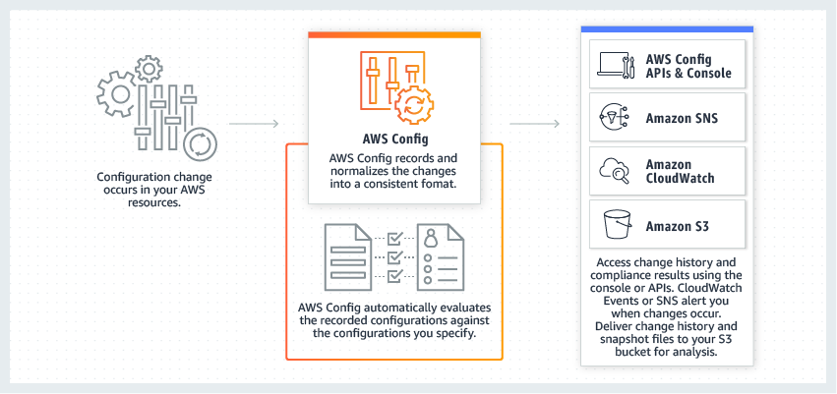

Slide 11
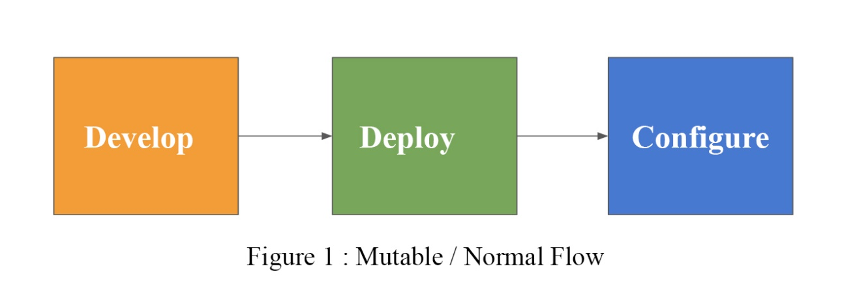
3
Mutable, changeable!
Need update and response time, every time

Slide 12
Immutable Infrustructures which means kill the server if you want to make a change. To reduce the time for creating and configuring machine images we need to develop complex infrastructure and modify each time whenever we needs an update.
4

Slide 13
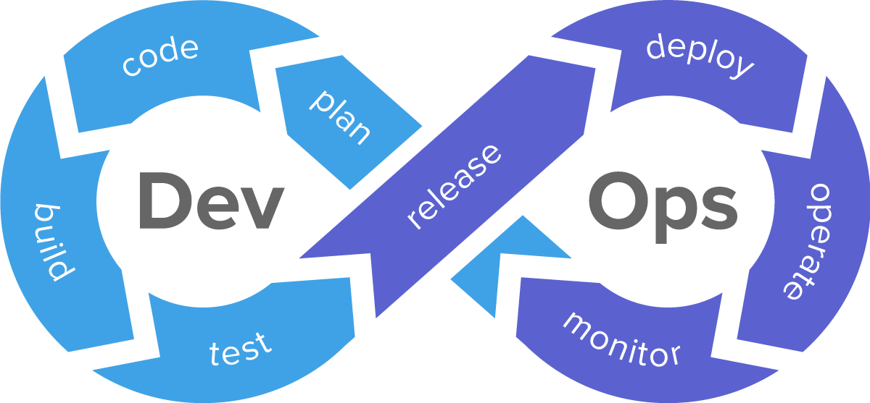

Slide 14
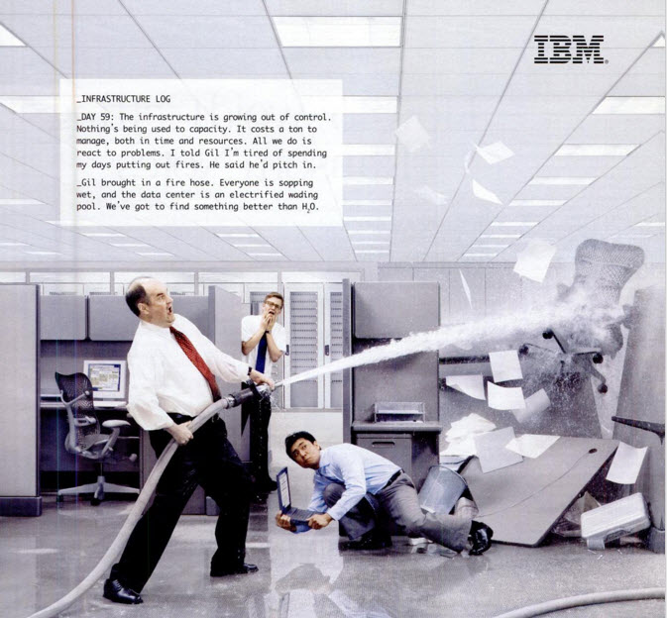
Back then when DevOPS wasn’t even a «thing» continuous integration, virtual machines, cloud computing, infrastructure orchestration, data-center automation and even the term “devops” were basically unknown.
6

Slide 15
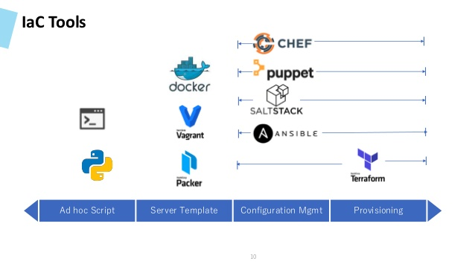
Back then when DevOPS wasn’t even a «thing» continuous integration, virtual machines, cloud computing, infrastructure orchestration, data-center automation and even the term “devops” were basically unknown.
7

Slide 16
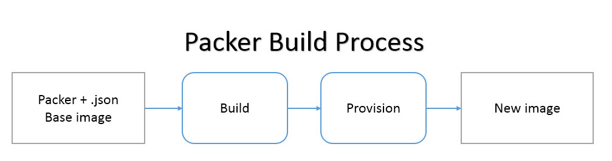
5
Numerous servers with specific configurations work for your clients ; you need Packer.

Slide 17
2)RELATED WORK

Slide 18
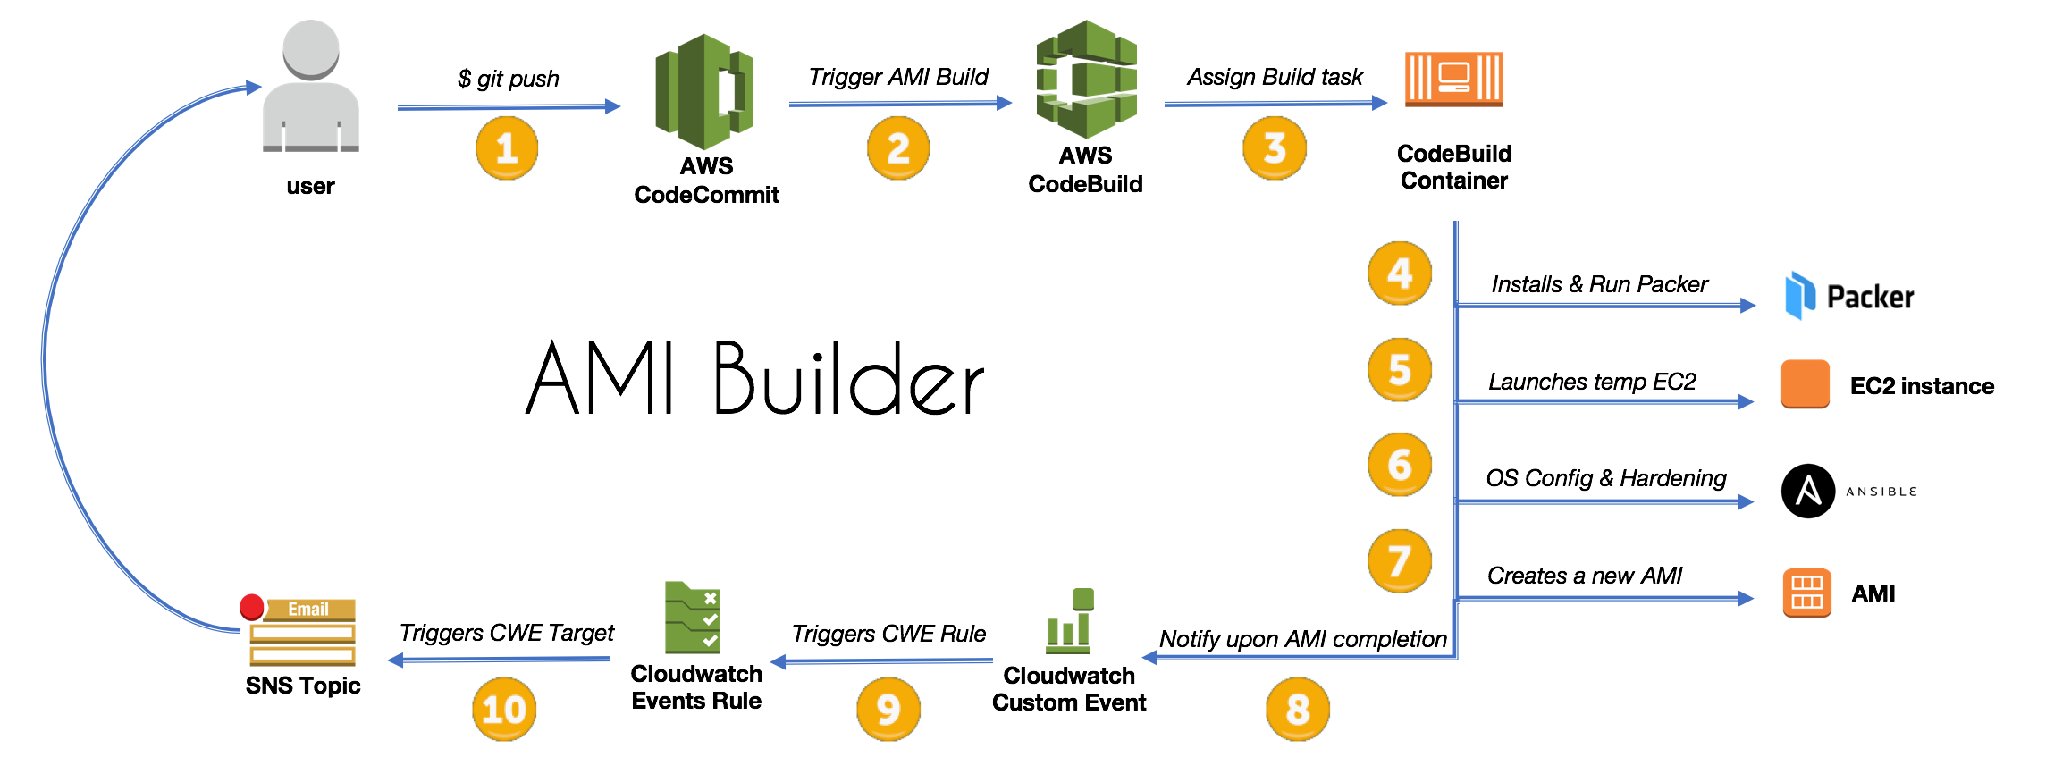

Slide 19
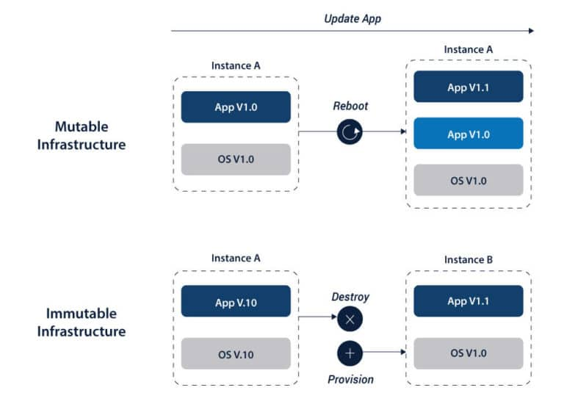
There are 2 basic types of infrastructures; mutable and immutable

Slide 20
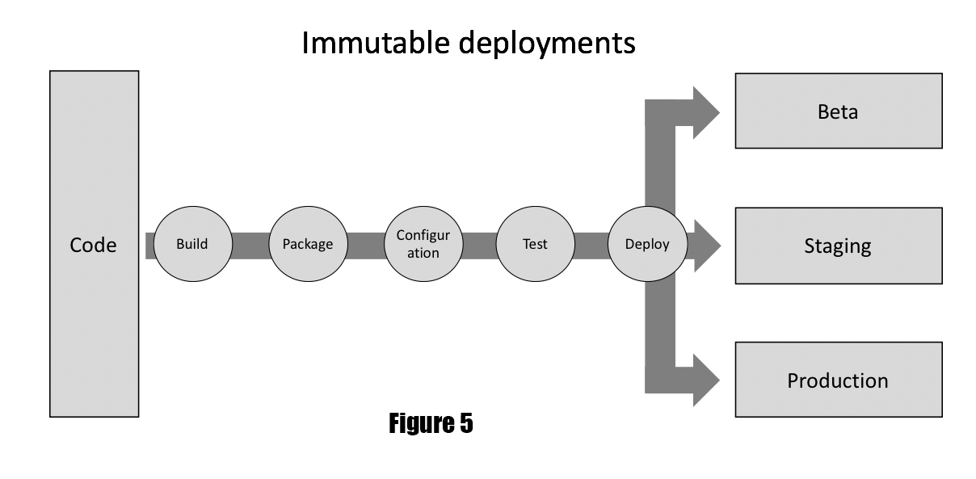

Slide 21
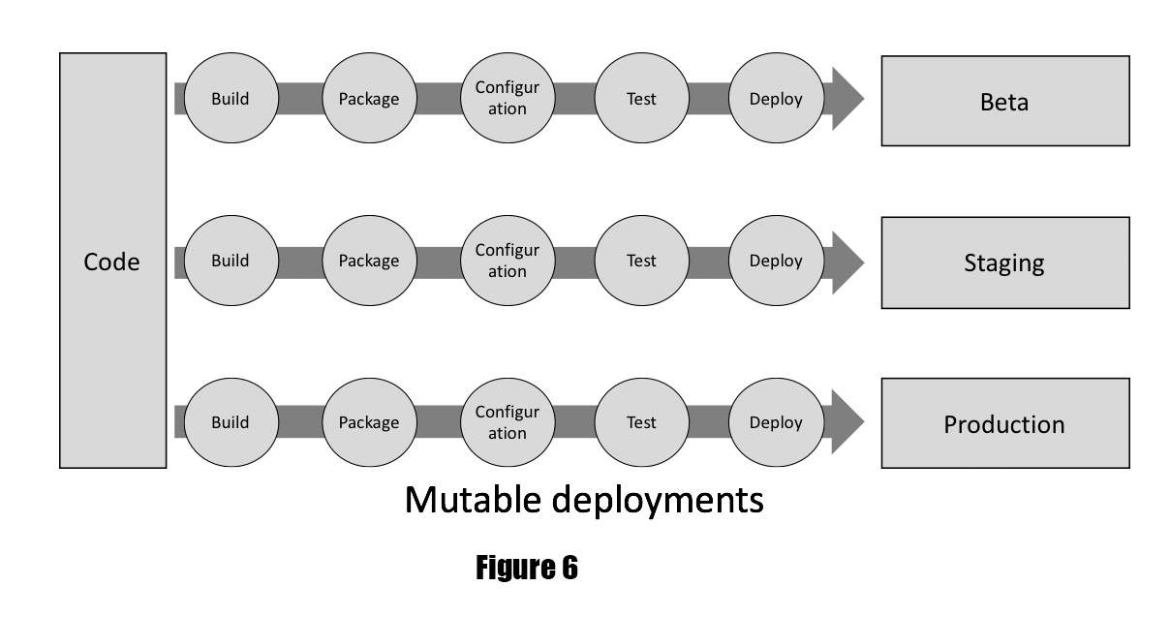

Slide 22
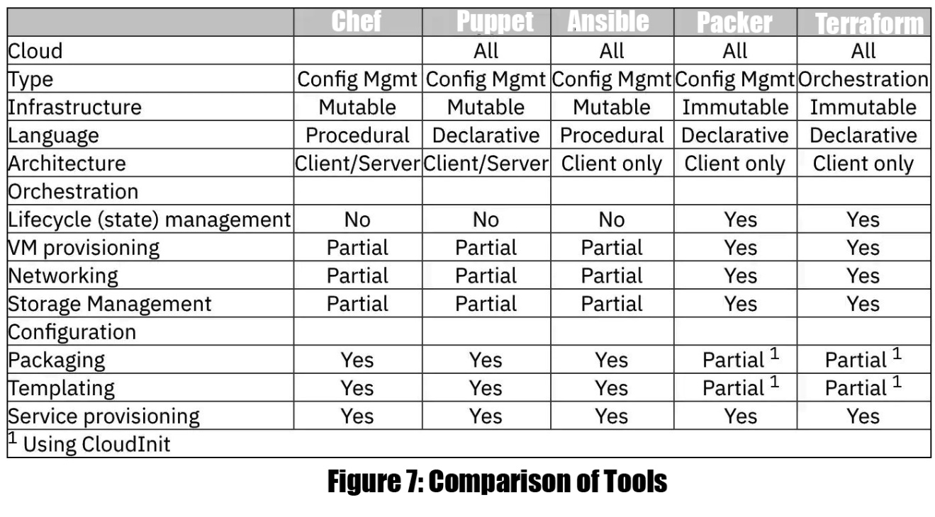

Slide 23
2.1. Existing Systems

Slide 24
Mutable Tools
Ansible
Chef,
Puppet,

Slide 25
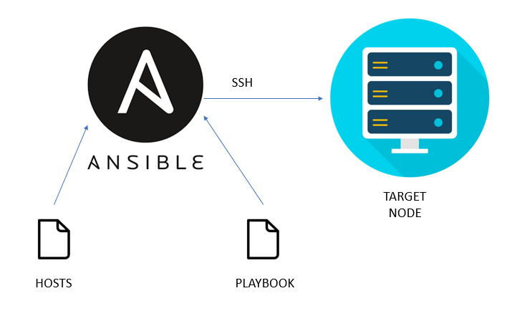

Slide 26
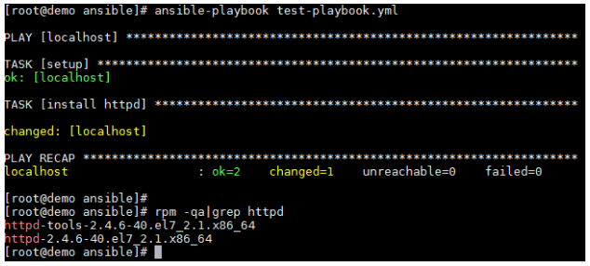
$ sudo apt-get upgrade
$ sudo apt-get update $ sudo apt-get install software-properties-common $ sudo apt-get check
$ sudo apt-add-repository --yes --update ppa:ansible/ansible $ sudo apt-get install ansible

Slide 27
Each playbooks has plays and only have inventories and variables.
Basic components of ansible :
Modules
Module utilities
Plugins
Inventory
Playbooks
The Ansible search path
Modules

Slide 28
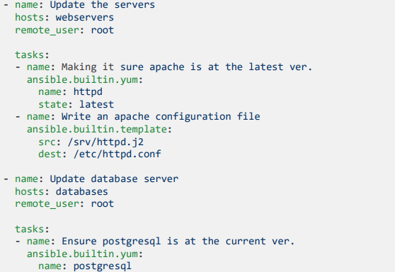
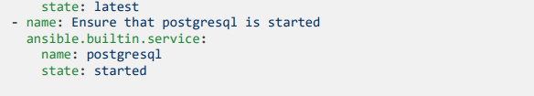

Slide 29
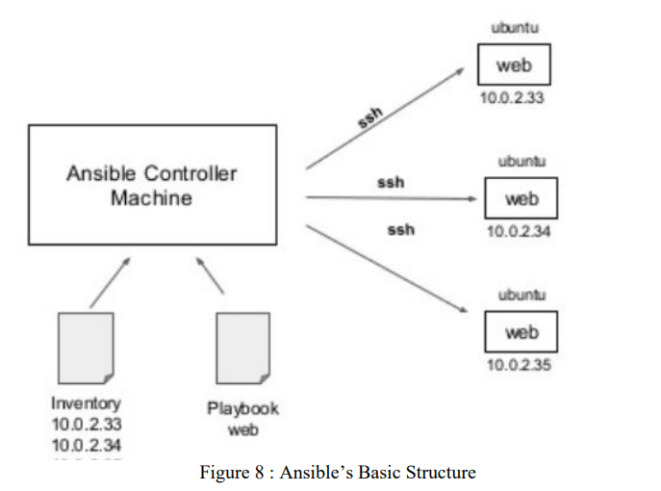

Slide 30
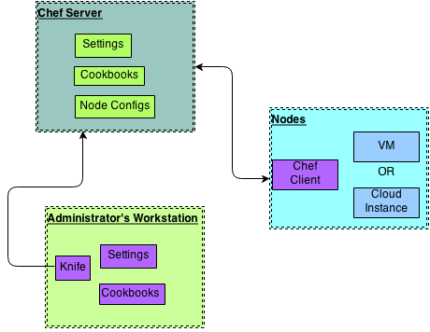

Slide 31
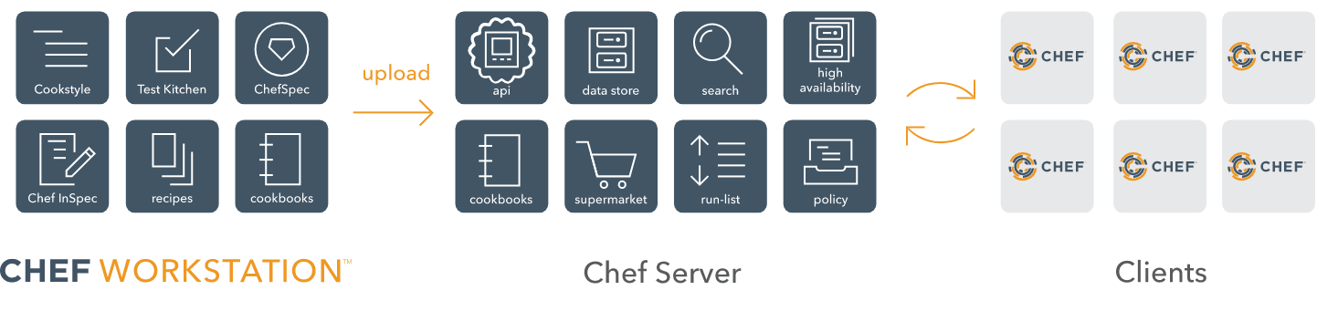

Slide 32
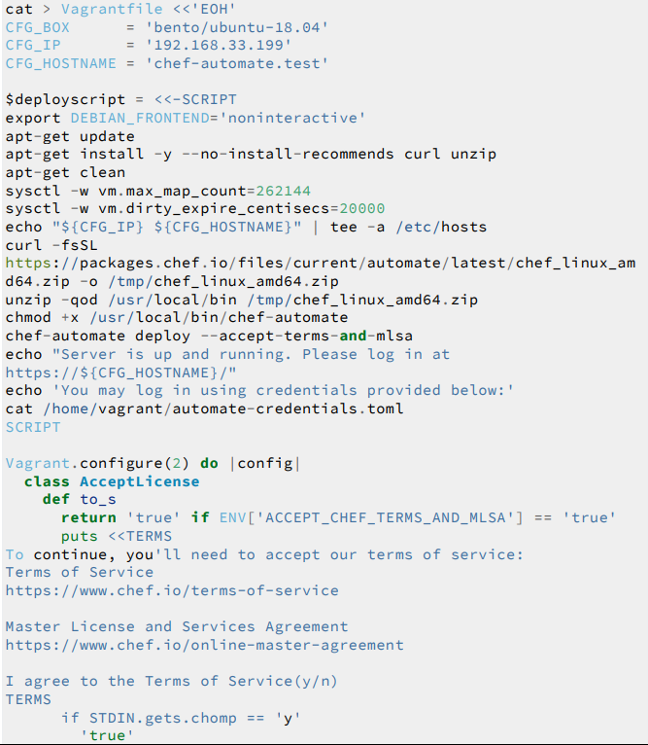

Slide 33
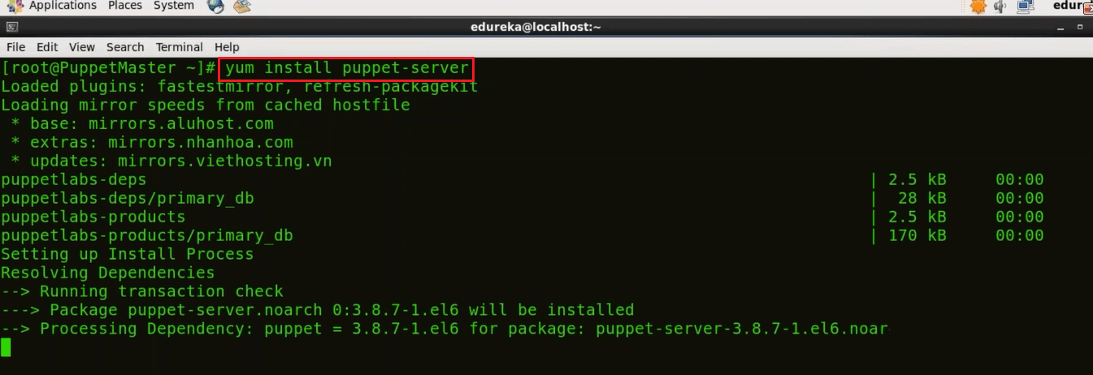

Slide 34
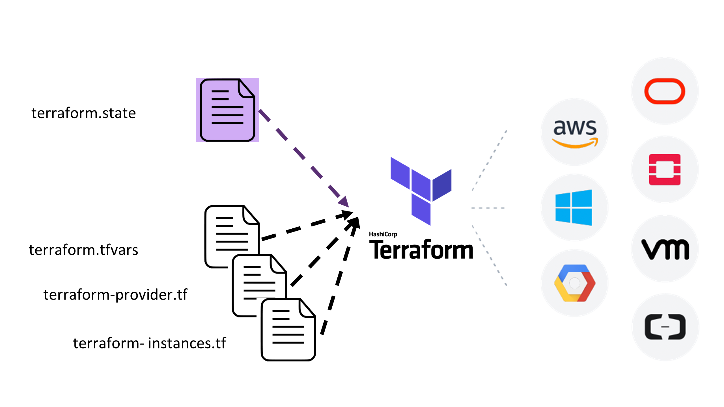

Slide 35
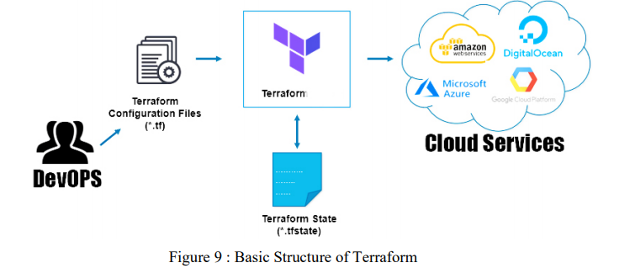

Slide 36
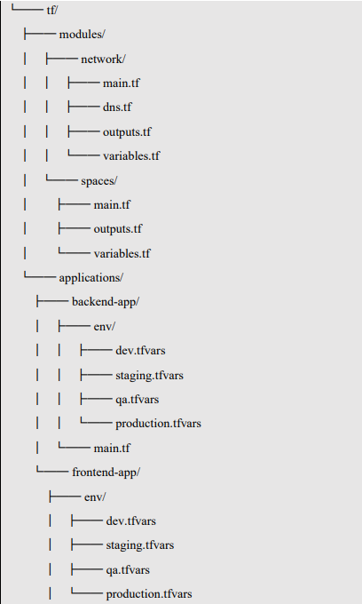
Terraform Structures

Slide 37
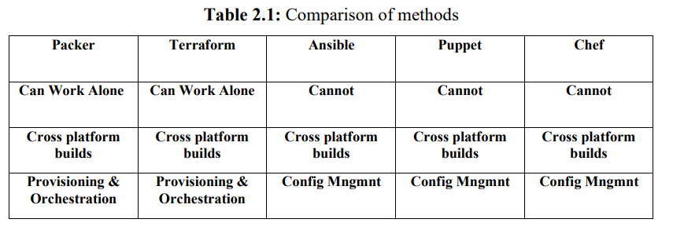

Slide 38
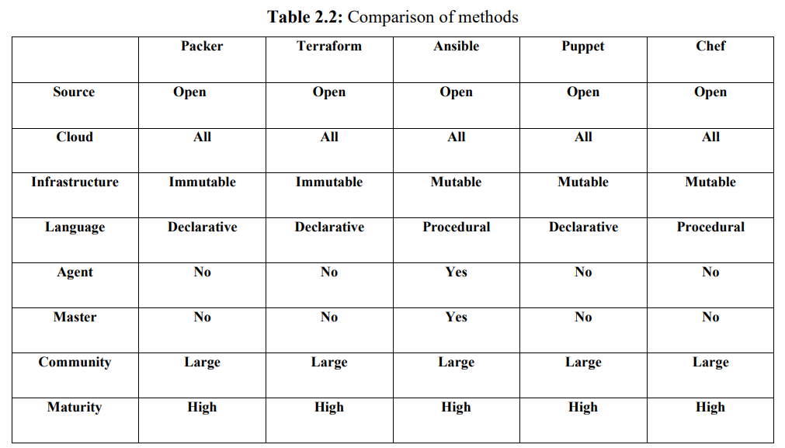

Slide 39
Terraform Structures

Slide 40
3.Methodology

Slide 41
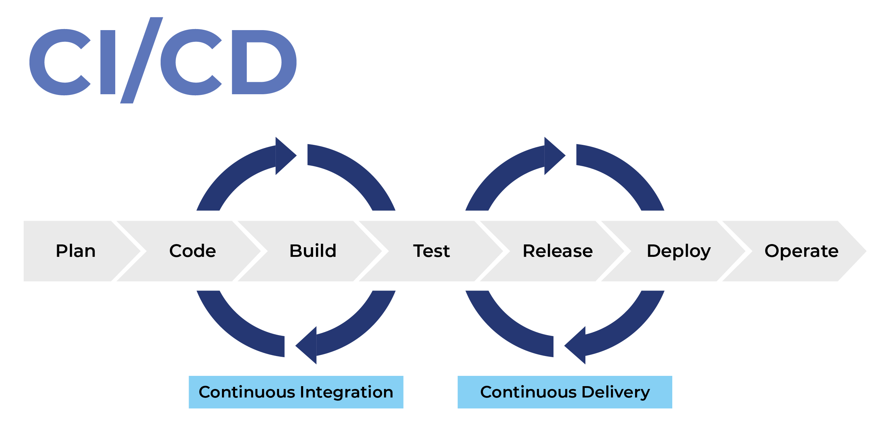

Slide 42
Steps of the implementations on AWS;
Set up your environment
Getting security Details
Choosing platforms and getting Pair keys as PEM file
Configuring IAM credentials
Running a Packer automation workflow

Slide 43
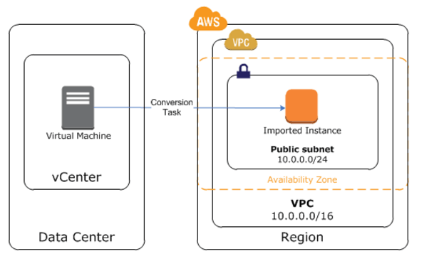

Slide 44
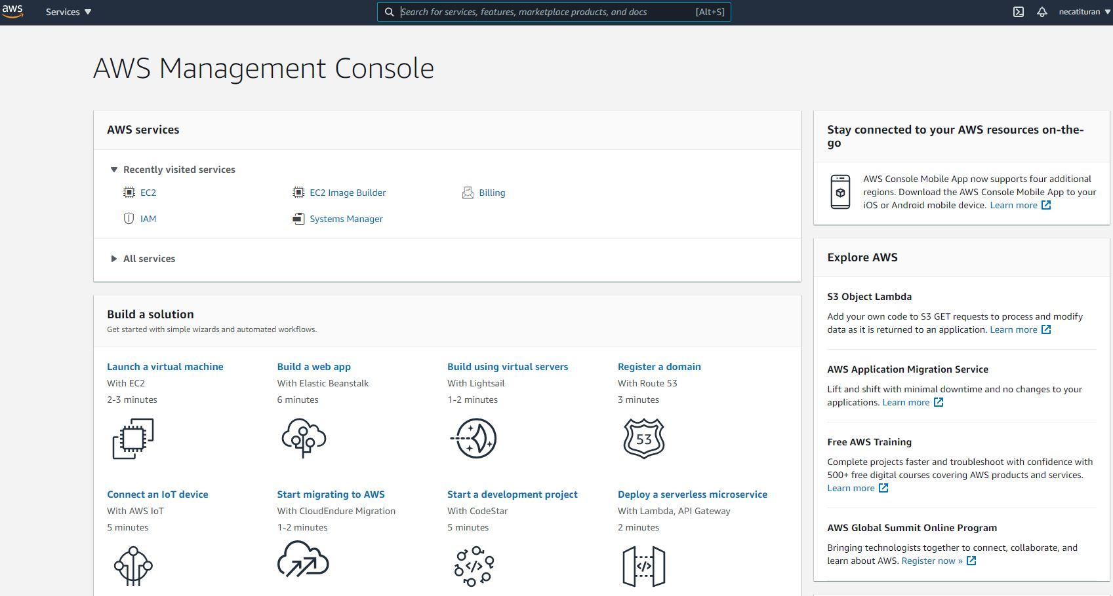

Slide 45
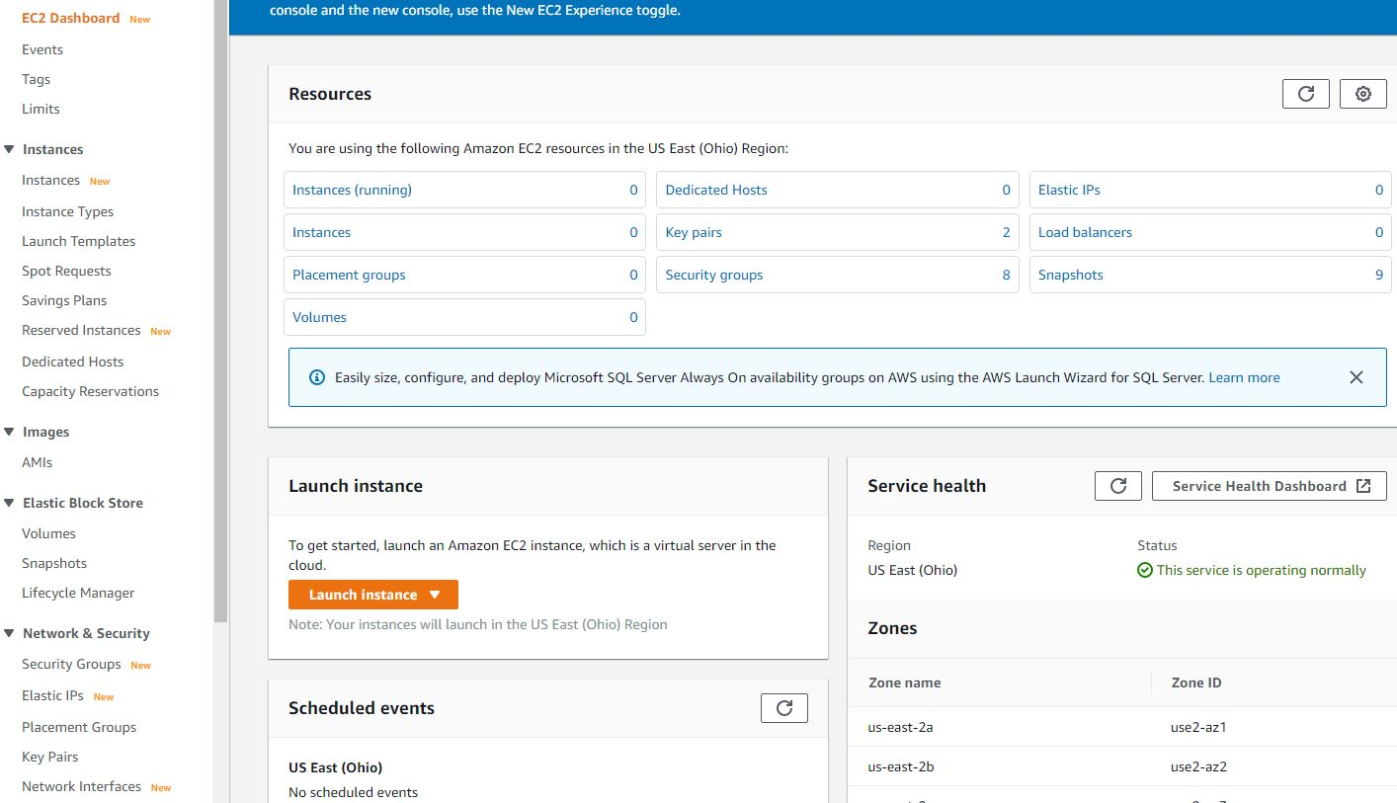

Slide 46
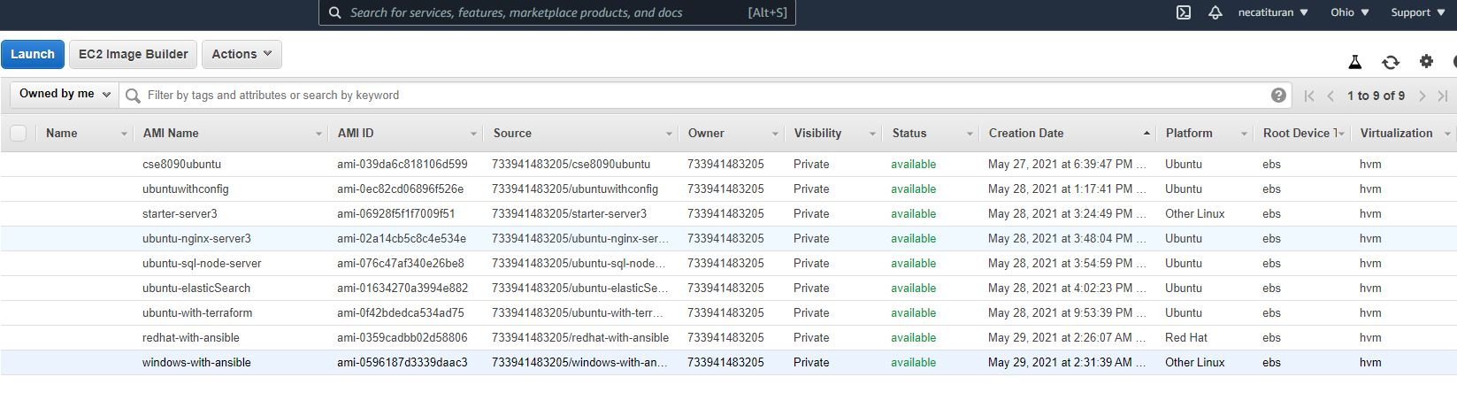

Slide 47
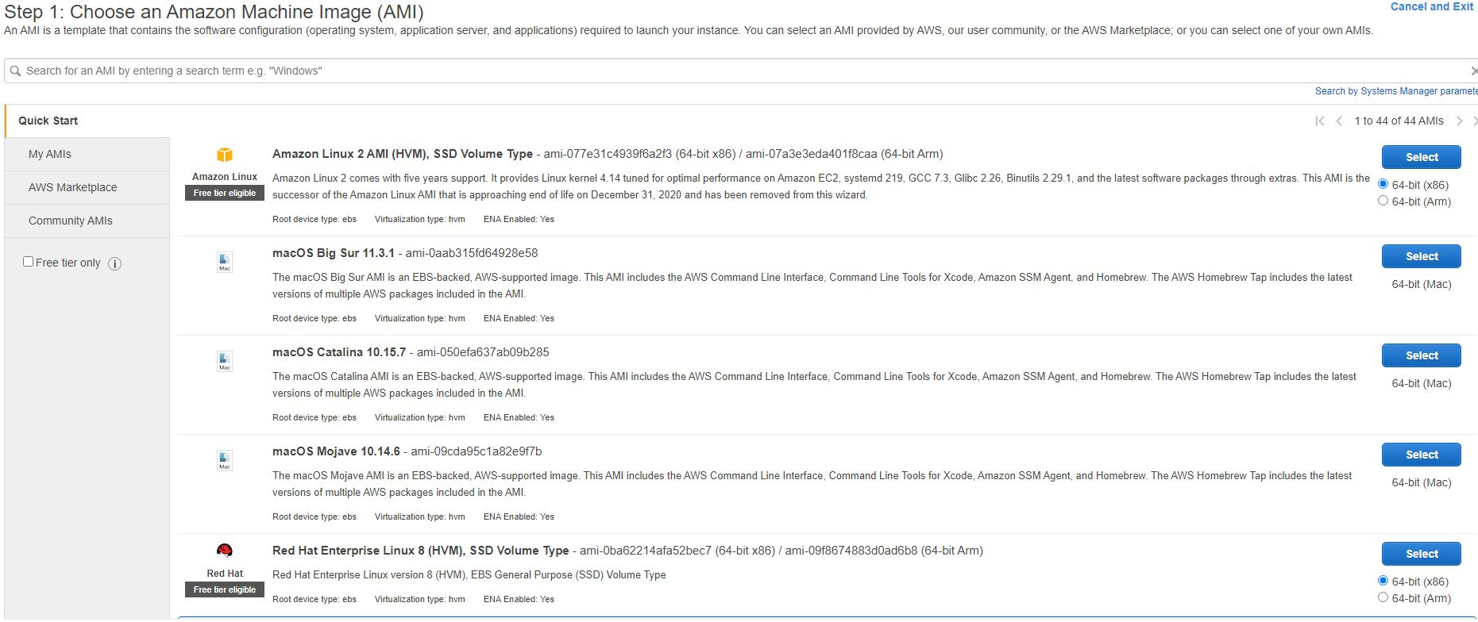

Slide 48
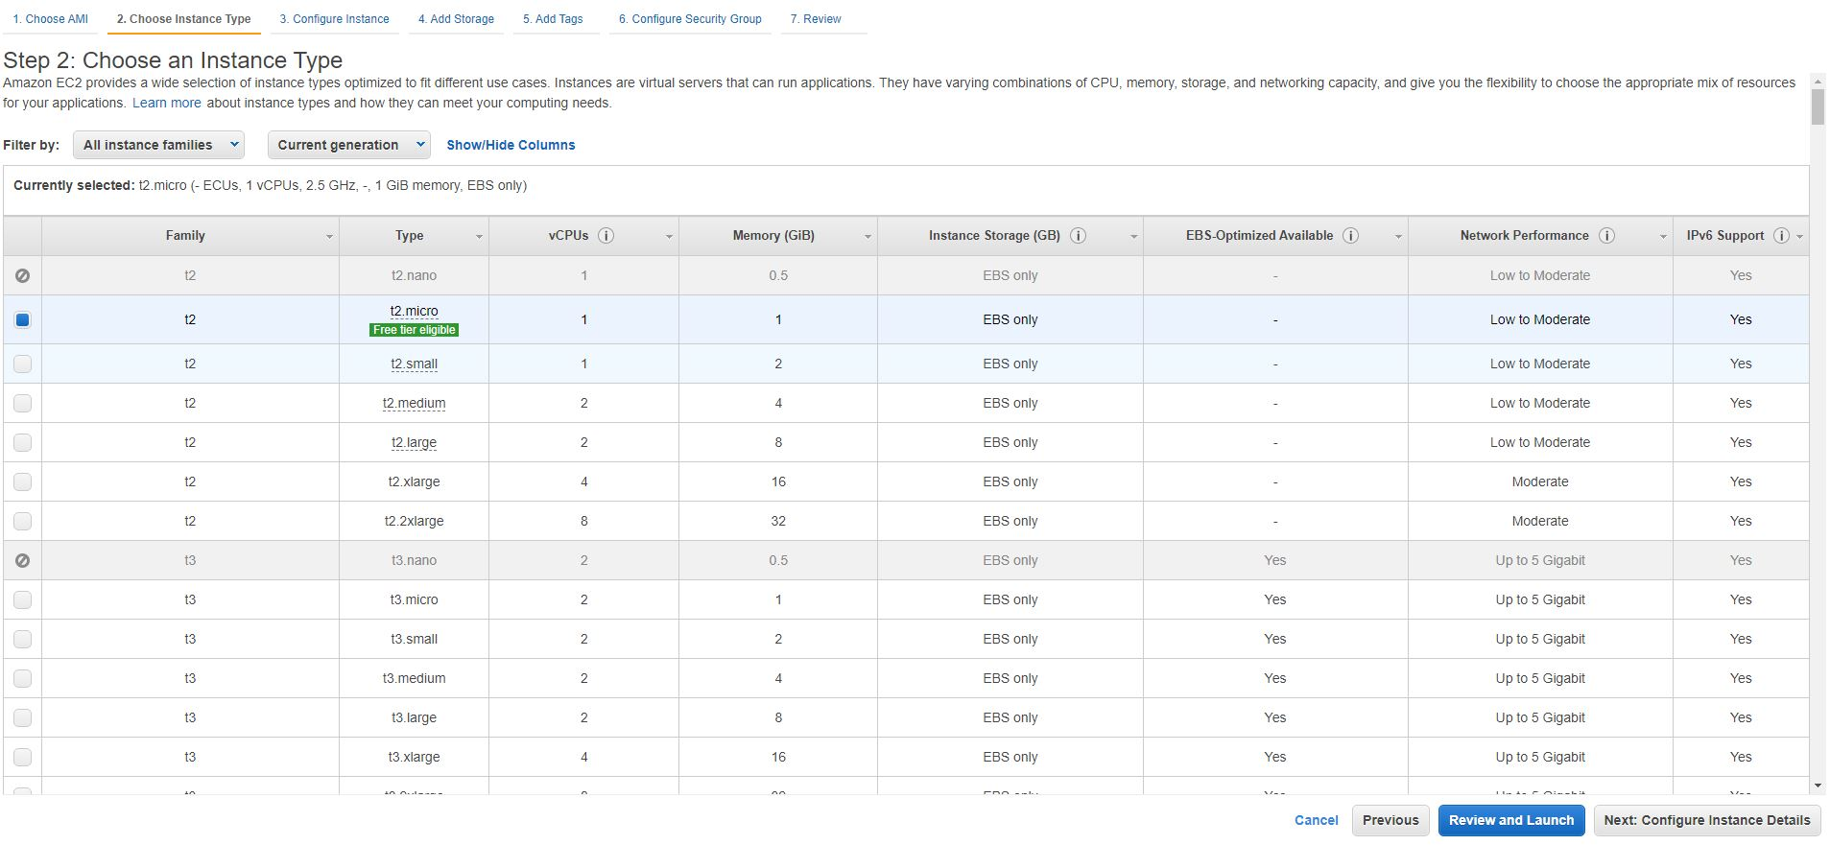

Slide 49
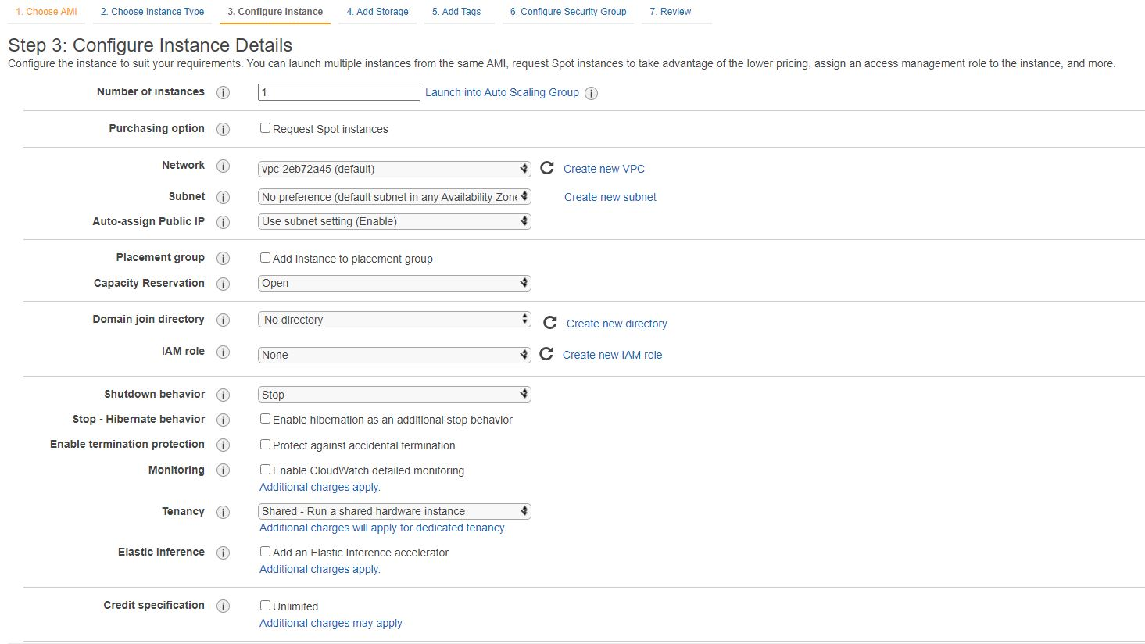

Slide 50
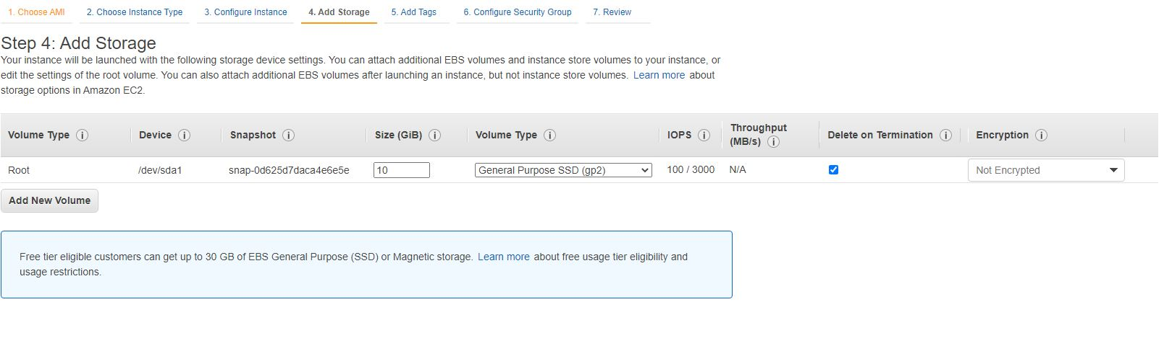

Slide 51
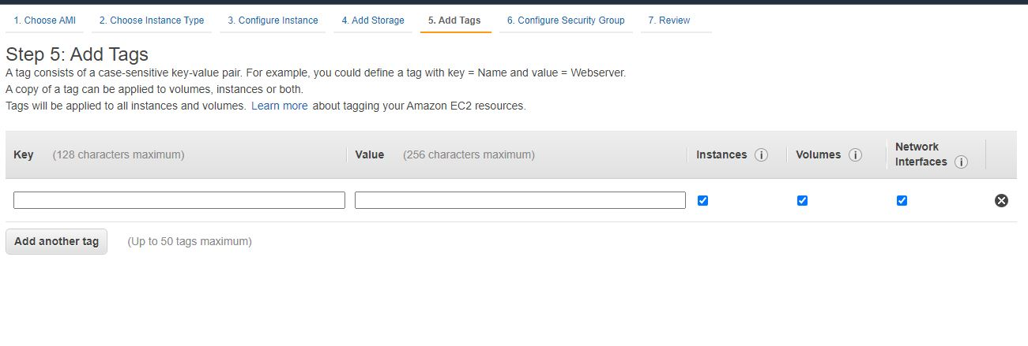

Slide 52
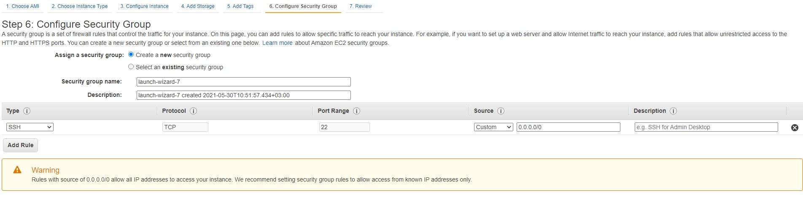

Slide 53
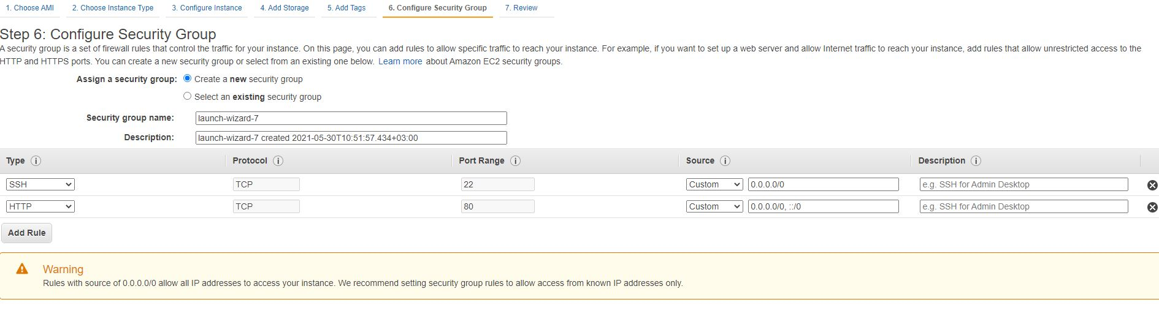

Slide 54
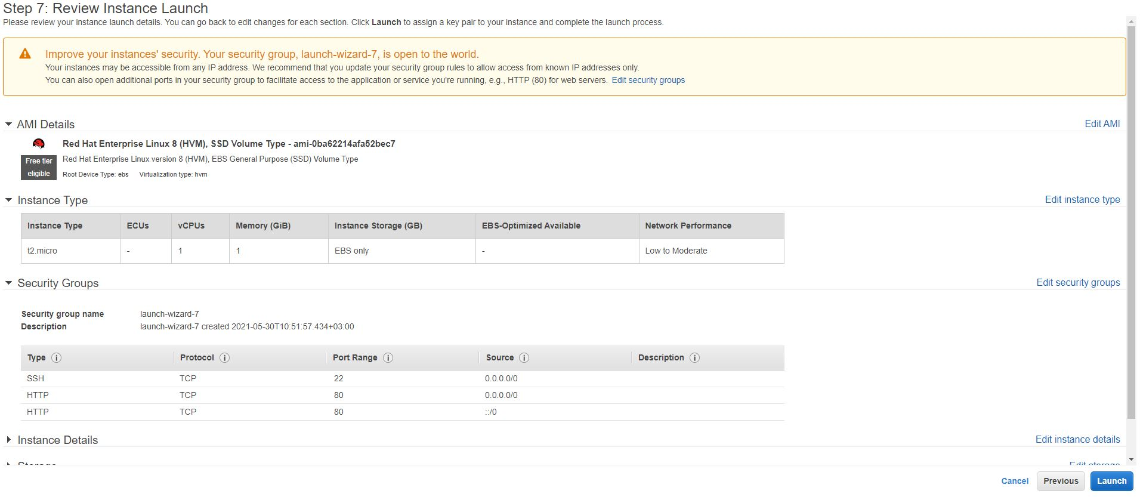

Slide 55
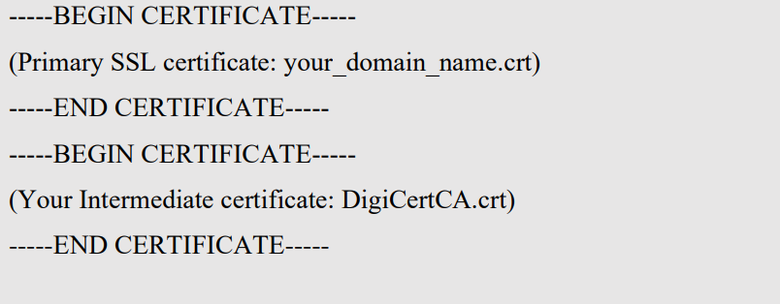

Slide 56
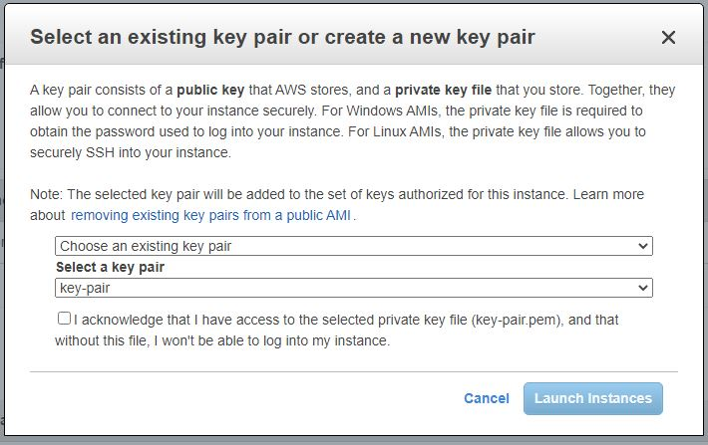

Slide 57
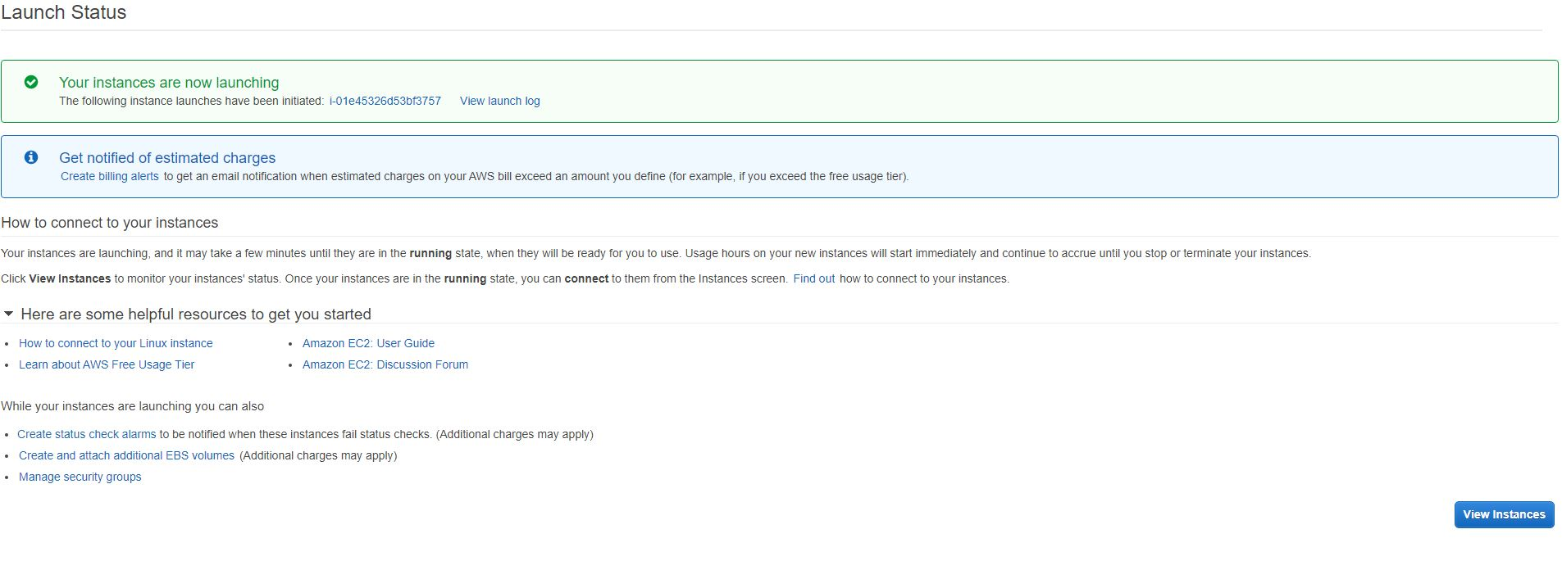

Slide 58
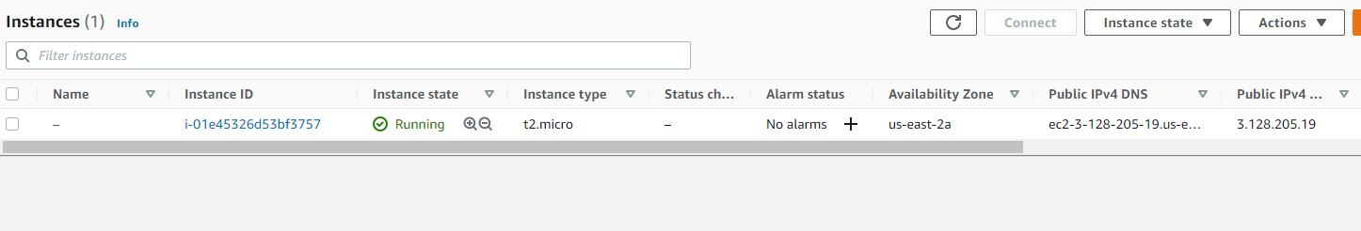

Slide 59
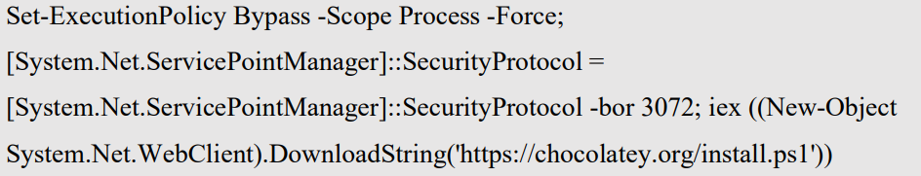

Slide 60
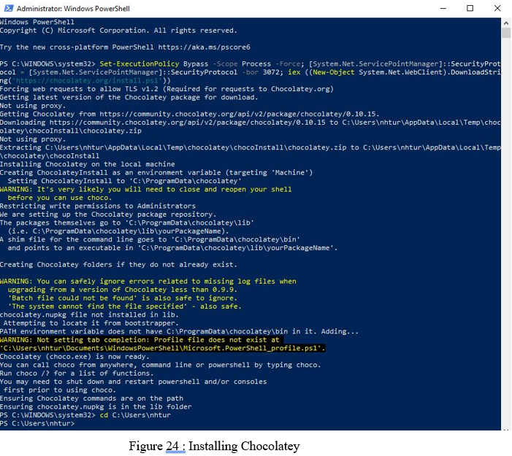

Slide 61



Slide 62
Packer has 6 fundamental component in its hierarchy;
• Builders
• Provisioners
• Variables/Templates
• Paralel Builds
• Post-Processors
• Communicators

Slide 63

BUILDER

Slide 64

PROVISIONER

Slide 65

Templates / Variables

Slide 66

Vault tokens

Slide 67


Slide 68

Parallel Builds

Slide 69


Slide 70
SETTING UP TO THE ENVIRONMENT

Slide 71
System Tools & Specifications
VS Code
Chocolatey
Powershell
Amazon AWS Account
Windows 10 OS

Slide 72


Slide 73



Slide 74


Slide 75


Slide 76


Slide 77


Slide 78


Slide 79


Slide 80


Slide 81


Slide 82


Slide 83

To make configurations, we need a set of Provisioners.

Slide 84


Slide 85


Slide 86


Slide 87


Slide 88


Slide 89

ssh -i C:\Users\nhtur\Downloads\key-pair.pem ubuntu@18.222.78.158

Slide 90


Slide 91
4. Experimental studies

Slide 92


Slide 93


Slide 94


Slide 95


Slide 96
DISCUSSION & CONLUSIONS

Slide 97
THANK YOU

